Slide 1
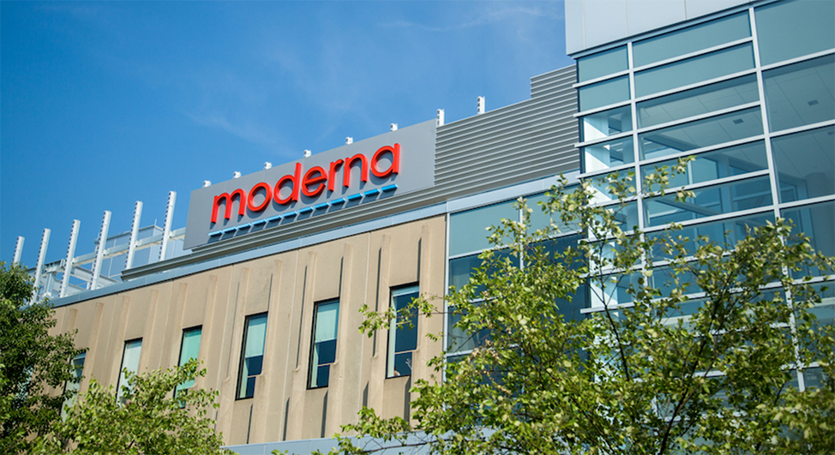
Moderna biotech startup company
Sit Dolor Amet

Slide 2
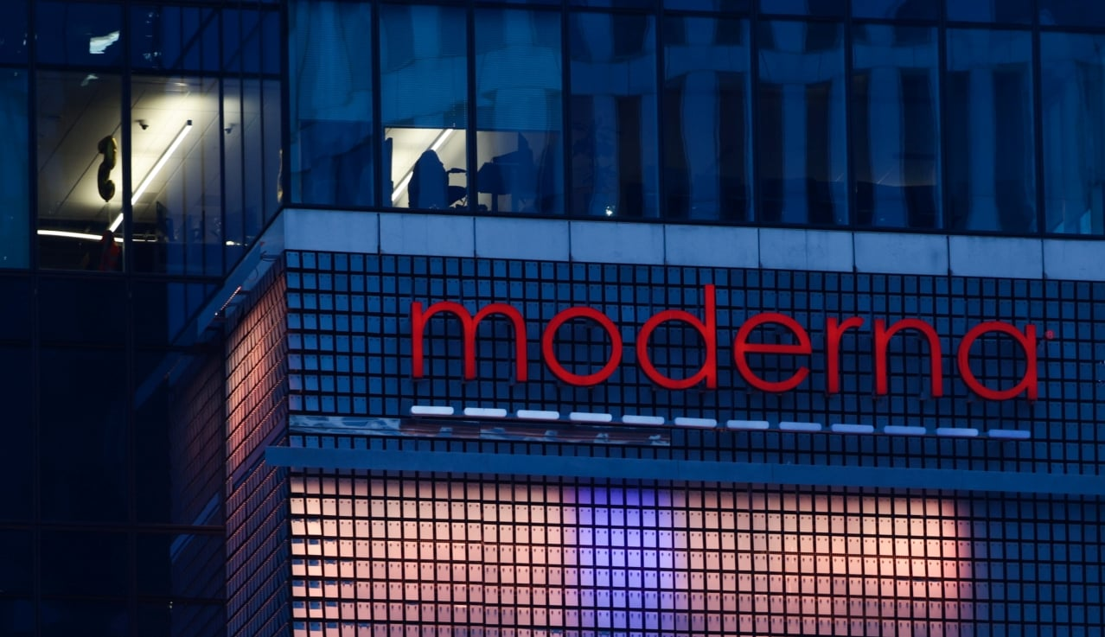
Introduction to Moderna Startup Country In an era defined by innovation and entrepreneurial spirit, Moderna Startup Country emerges as a dynamic hub fostering creativity, technology, and scalable solutions. With a vision to empower startups and catalyze economic growth, it provides resources, mentorship, and a collaborative ecosystem, transforming ideas into impactful ventures. This initiative positions itself at the forefront of modern entrepreneurship, championing innovation as a driving force for societal and technological advancement. Moderna is a biotechnology company based in Cambridge, Massachusetts, founded in 2010. It specializes in mRNA technology, which uses messenger RNA to instruct cells to produce proteins that help prevent or treat diseases. The company’s mission is to revolutionize medicine by harnessing mRNA for vaccines and therapeutics across infectious diseases, oncology, rare diseases, and autoimmune conditions

Slide 3
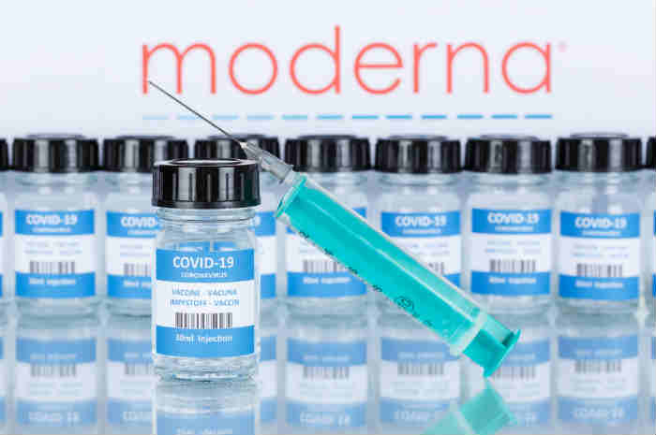
Products by moderna
Approved products:
Its commercial products include:
COVID-19 vaccine (Spikevax) continues to be updated for emerging variants such as LP.8.1 and is included in seasonal vaccination programs
Respiratory synthetic virus (RSV) vaccine (mResvia / mRNA-1345) – Approved in 2024 for adults 60 and older
This Photo by Unknown Author is licensed under CC BY-NC-ND

Slide 4
Clinical Pipeline and Ongoing Innovations
Moderna has a robust pipeline of over 44 candidates with 37 in clinical trials, targeting multiple therapeutic areas.
Wikipedia
Combination Respiratory Vaccines: mRNA-1083 combines influenza and COVID-19 vaccines into a single shot, aiming for easier annual immunization.
Oncology: Personalized cancer vaccines like mRNA-4157 in partnership with Merck train the immune system to recognize tumor-specific mutations, with trials underway for melanoma and other cancers.
Latent Virus Vaccines: Candidates for Epstein–Barr Virus (EBV), Cytomegalovirus (CMV), and Norovirus are in development, with some reaching late-stage trials.
Rare Disease Therapeutics: program target conditions like propionic acidemia and cystic fibrosis, using mRNA to produce functional proteins in affected cells

Slide 5
Applications, Partnerships & Global Expansion
UK Innovation and Technology Centre (MITC), Harwell: Can produce up to 250 million vaccines/year in a pandemic scenario.
Collaborations in Canada, Australia, and Europe expand manufacturing and onshore capabilities to support Regulatory approvals and responses from public health authorities.
Partnerships with Merck, AstraZeneca, Vertex Pharmaceuticals, and defense agencies like DARPA accelerate research.
Stock and financial historical performance:
Year | Revenue (USD millions) | Net Income (USD millions)
2019 | 60 | (514)
2020 | 803 | (747)
2021 | 18,471 | 12,202
2022 | 19,263 | 8,362
2023 | 6,848 | (4,710)
2024 | 3,200 | (3,600)

Slide 6
Challenges faced by moderna
Competitor | Strengths | Threat to moderna
Pfizer | Global scale, diversified portfolio | Dominates vaccine market
BioNTech | Strong mRNA R&D, partnerships | Competes directly in mRNA vaccines
CureVac | Cost-efficient mRNA tech | Threat in emerging markets
Novavax | Protein-based vaccines | Alternative to mRNA vaccines

Slide 7
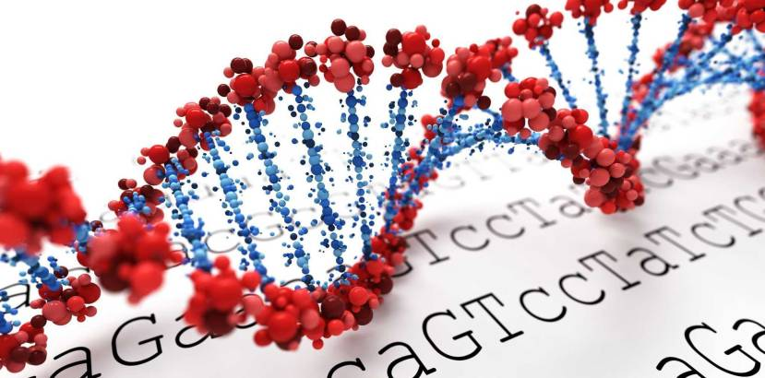

Revenue decline: 2024 revenue dropped to $3.2 billion, with projections of $1.5–$2.5 billion in 2025, reflecting reduced COVID-19 vaccine demand.
Profitability issues: Gross margin at -105.8%, operating margin -126.4%, and net margin -145.2% in 2026.
Competition: Direct rivals include Pfizer, BioNTech, CureVac, and Novavax, all advancing mRNA and vaccine pipelines.
Diversification pressure: Heavy reliance on Spikevax (COVID-19 vaccine) forces Moderna to push new products like RSV vaccine (mRESVIA) and oncology therapies.
Regulatory hurdles: Approval timelines for new vaccines and therapies remain uncertain, slowing market entry.
Cost efficiency: Targeting cash breakeven by 2028 through operational streamlining.
This Photo by Unknown Author is licensed under CC BY
This Photo by Unknown Author is licensed under CC BY

Slide 8
Recent revenue of moderna
Year Revenue ($B) Bar Representation
2021 18.0 ██████████████████████████████████████████
2022 10.0 ████████████████████████
2023 6–7 ███████████████
2024 3.2 ████████
2025 1.9 ████
2026 est. ~2.1 █████

Slide 9
Market impact
Global market impact
Scientific and healthcare impact
COVID-19 vaccine dominance: Moderna’s Spikevax was one of the first widely distributed mRNA vaccines, generating $19.26 billion in 2022 revenue and proving the viability of mRNA platforms.
Acceleration of biotech investment: Its success triggered massive venture capital and government funding into mRNA startups and biotech innovation.
Shift in vaccine development: Traditional vaccine timelines (10–15 years) were compressed to under 1 year, setting new industry standards.
Proof of mRNA viability: Moderna validated mRNA as a platform for vaccines and therapeutics, opening doors for oncology, rare diseases, and personalized medicine.
Pipeline expansion: Beyond COVID, Moderna is advancing vaccines for flu, RSV, HIV, mpox, and Zika, plus oncology treatments.
Regulatory precedent: Agencies like the FDA and EMA adapted faster review processes for mRNA-based therapies.

Slide 10
Exceptional data points
Impact Area | Exceptional Data | Significance
Revenue peak | $19.26B in 2022 | One of the highest ever for a biotech
Stock growth | +700% (2020–2021) | Historic surge in biotech valuation
Global reach | 70+ countries | Rapid worldwide distribution
R&D pipeline | 45+ programs | Diversification beyond COVID
Litigation impact | $0.9B settlement in 2026 | Shows risks of IP disputes

Slide 11
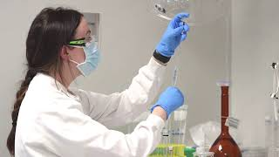
Conclusion
Moderna has proven itself as a pioneer in mRNA technology, reshaping the future of medicine with its breakthrough COVID-19 vaccine and expanding pipeline. While the company faces challenges such as declining revenues, regulatory hurdles, and global access issues, its commitment to innovation remains clear.
With ongoing work in seasonal vaccines, oncology treatments, and rare diseases, Moderna is transitioning from a pandemic-driven company to a diversified biotech leader.
Ultimately, Moderna’s journey highlights the transformative power of science, the importance of global collaboration, and the potential of mRNA to redefine healthcare for generations to come.

Slide 12


